Slide 1


Design and Analysis of Algorithm(CS2271)
Semester 04
Assignment 02:-
Group Members:-
Anish Banerjee (2021CSB001)
Joyabrata Acharya(2021CSB011)
Sk Fardeen Hossain(2021CSB023)
Kruskal Minimum Spanning Tree Algorithm
Source Codes and Documentations are available at Github
Indian Institute of Engineering Science and Technology, Shibpur

Slide 2
Index
SL. NO.​ | TOPIC​ | SUBTOPICS​
1​ | Polygon Triangulation | ​Preparing dataset of convex polygons Brute Force Approach Dynamic Programming Approach Greedy Approach Checking correctness of greedy Approach
2​ | Data Compression Strategies | Shannon-Fano encoding scheme Huffman Encoding Scheme Instantaneous decoding algorithm Huffman coding on a Large text document Examination of optimality of coding by comparing with other documents
3​ | ​Union Find on Large Real-Life Datasets | ​Realizing Disjoint set operations on large real-life datasets from SNAP and KONECT Implementing graph algorithms like connected-components and Minimum Spanning Tree using Union-Find Operations

Slide 3
Polygon Triangulation Problem
Polygon triangulation problem is a famous computational geometry problem that tells us to find the minimum cost of triangulation.
Triangulation refers to process of breaking the polygon to a number of triangles by drawing diagonals between non-adjacent vertices such that no two diagonals intersect.
Cost refers to the cost of triangulation that is the sum of perimeters of all the triangles formed after triangulation has been done.
For more we can refer here

Slide 4
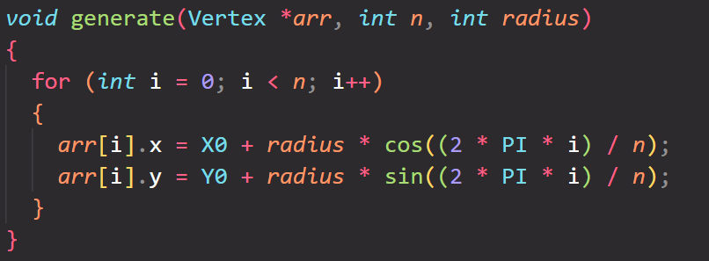
Dataset Preparation
Here we will be constructing convex polygons and regular polygons(which is also convex) by using concepts of vector algebra.
A regular polygon of n vertices can easily be constructed using the fact that all the vertices are equidistant on a circle of given radius; giving the hint that they lie on the De-Moivre's Circle.
:- Code Snippet for generating regular polygons

Slide 5
Convex Polygon Generation
A convex polygon can also be generated on the fact that while taking consecutive cross products of two adjacent sides of the polygon; the sign of the cross-product for all the pair of sides must remain same. This distinguishes a regular polygon from a convex one.
The source code can be found in the repo, and we have used the above fact in our algorithm by iteratively checking for convexity while generating the vertices for our polygon.

Slide 6
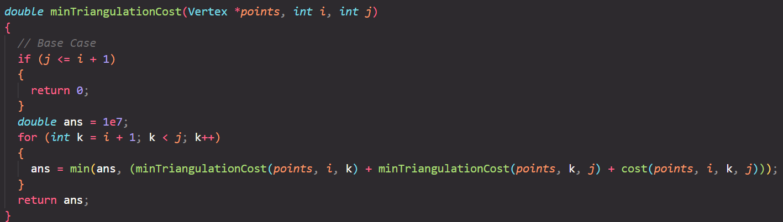
Brute Force Approach
We know that a convex polygon of n vertices can be triangulated into n-2 triangles, our job is to find the most optimal(minimum perimeter) combination of the possible n-2 triangles.
The naïve approach to solving this problem is to look at all the possible cases, i.e., dividing the polygon into 2 sub-polygons and 1 triangle and then recursively adding the cost of the triangle to the cost of the 2 sub-polygons. The terminating condition for the recursion will be when there are less than equal to 2 vertices left in which case we will just return 0.
Code Snippet for brute force approach

Slide 7
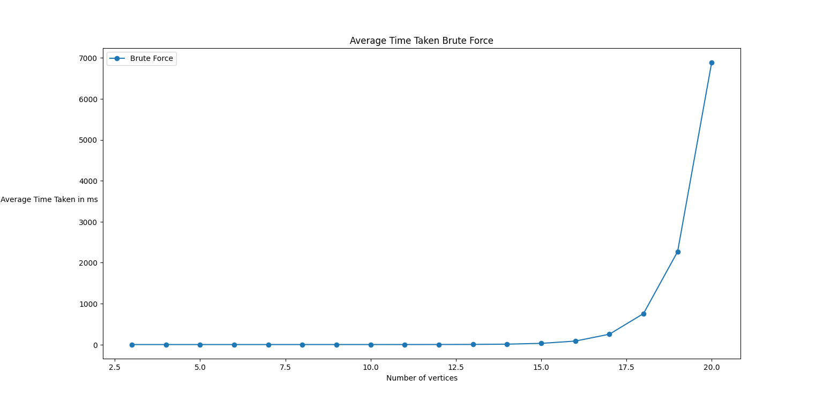
Observation and Analysis of Brute Force Approach
We have implemented the naïve approach on a dataset of regular convex whose vertices range from 3 to 21 and each vertices has around 50 rounds for a clear average case analysis.
Theoretically it seems that the time complexity is exponential and it seems to be of the order of the catalan number, thus the time complexity in the worst case and average case will be 4^n/(n^1.5).
As we can see from the figure aside, the time taken for the naïve approach to compute the min. Triangulation cost is exponentially rising with the number of vertices.
The question comes that can we optimize this approach to reach a polynomic time complexity

Slide 8
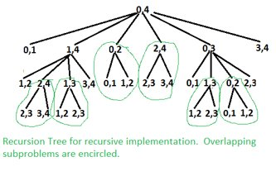
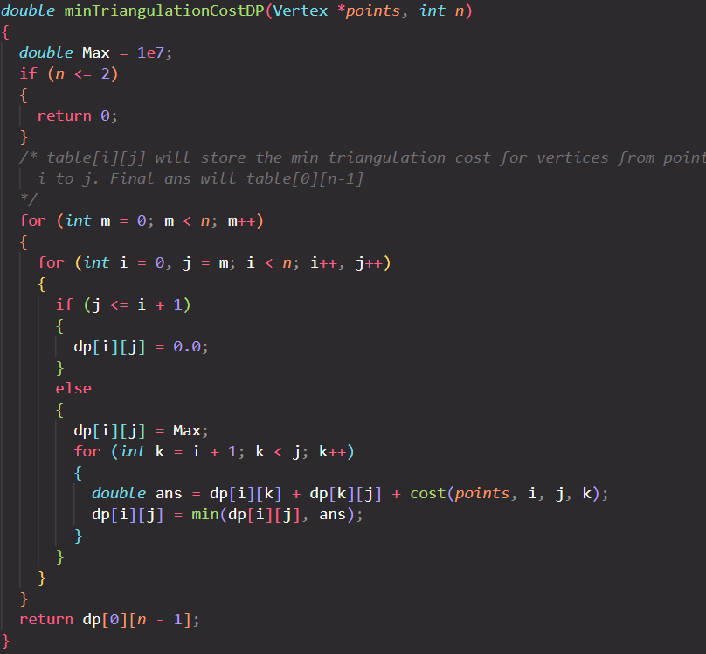
Dynamic Programming Approach
The dynamic programming approach uses the fact that the recursive solution posed by the naïve approach had an optimal substructure and overlapping subproblems. This can be justified from the fact that when we are checking for triangulation possibilities the shortest perimeter triangles will always come in our answer that is they will always be found being overlapped with different branches in the recursion tree.
So the natural implication will be to store the minimum value result in a table for indices say I to J and whenever we need to find the cost for triangulation of indices from I to J we can easily look it up from the table thus preventing extra computation
The table will be 2 dimensional as one dimension is for the start index and the other dimension is for the end index. So the answer will be dp[0][n-1]; considering n vertices.
Code snippet for DP approach
From the code aside it is pretty obvious that we have to loop for all vertices(2 loops) and then check all possible intermediate vertices(1 loop), we have 3 loops in our functions so the worst case time Complexity will be O(N^3), N being the number of vertices

Slide 9
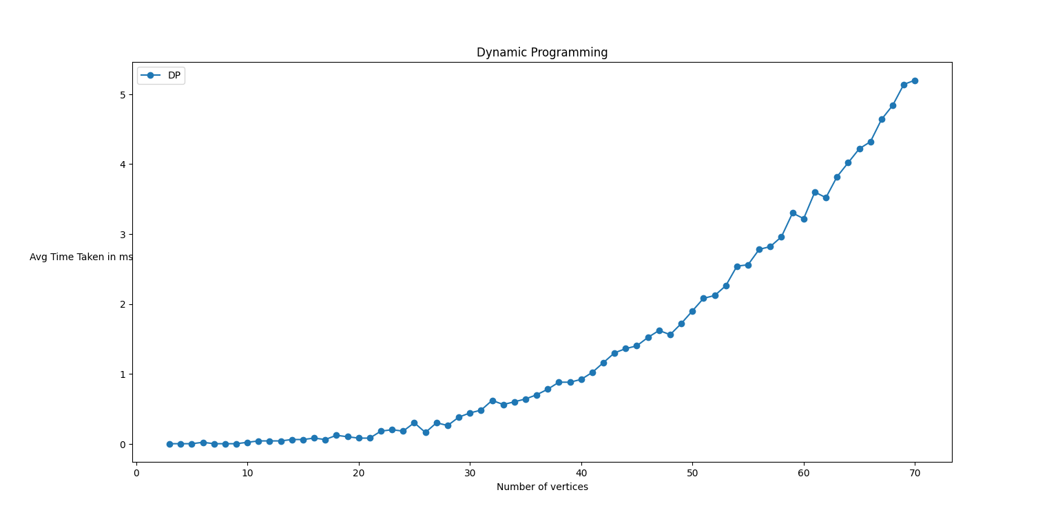
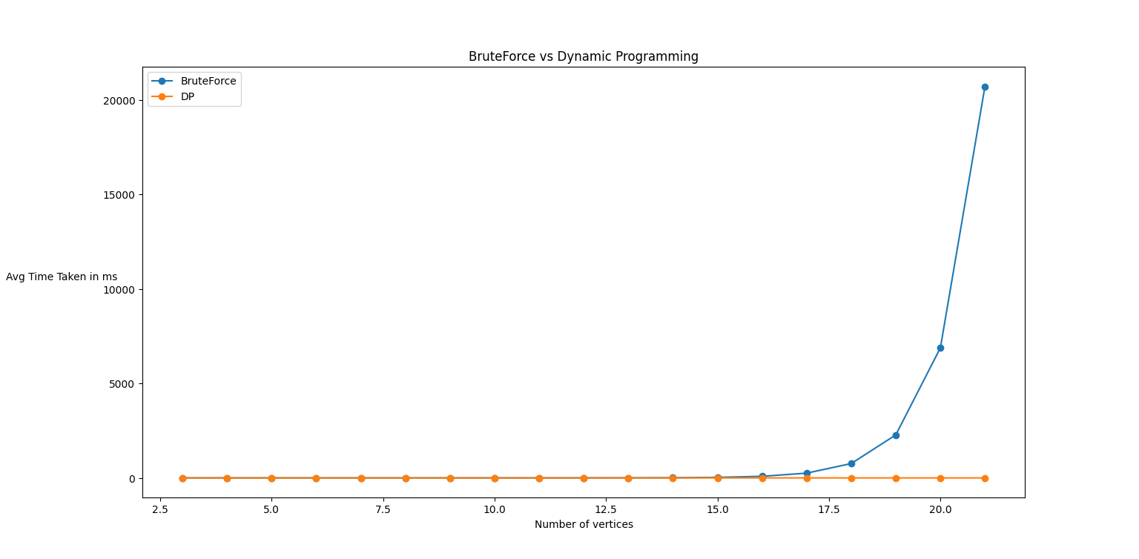
Observation and Analysis of DP Approach
From the snippet we have seen in the previous slide, the dynamic programming approach leads to worst case time complexity of O(N^3) which significantly reduces it from a non-polynomic time –complexity provided by the naïve approach.

Slide 10
Greedy Strategy
Another strategy to solve this problem is to greedily select non-intersecting diagonals in an ascending order of length by ear clipping the polygon at three adjacent vertices and adding them to our answer .
The problem with this greedy approach is that it does not satisfy the exchange property when this problem is mapped to a greedy matroid, because it does not guarantee the optimality of the solution that adding shorter perimeter triangles will not lead to larger perimeter triangles since we are already narrowing the search space by the keyword 'non-intersecting' which must be followed.
So it is expected that the greedy solution will not give optimal results than the DP one but it is helpful in situations which demands time and there is less significance to minute deviation from the optimal result.

Slide 11
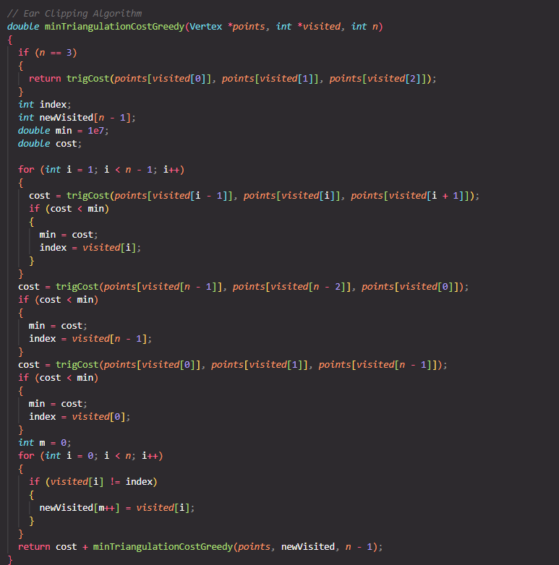
Code Snippet
From the code snippet aside we can clearly see that we are clipping smaller perimeter triangles from the polygon and adding its perimeter to our answer. We maintain the non-intersection condition by maintaining a visited array whose size keeps on decreasing by 1 in the recursive cycle.
Each recursive cycle in the worst case performs O(n) work and there are n-2 recursions taking place(including the base case which takes O(1) time) the total time complexity of the greedy algorithm will be O(N^2) which is better than the DP but the result will vary due to lack of optimal structure in the greedy approach.

Slide 12
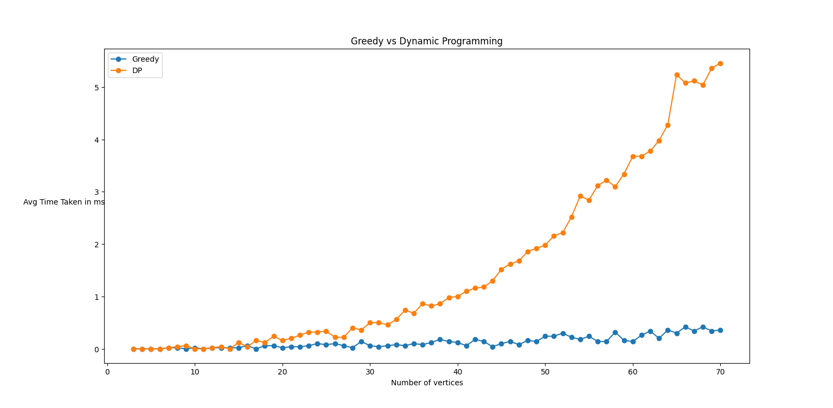
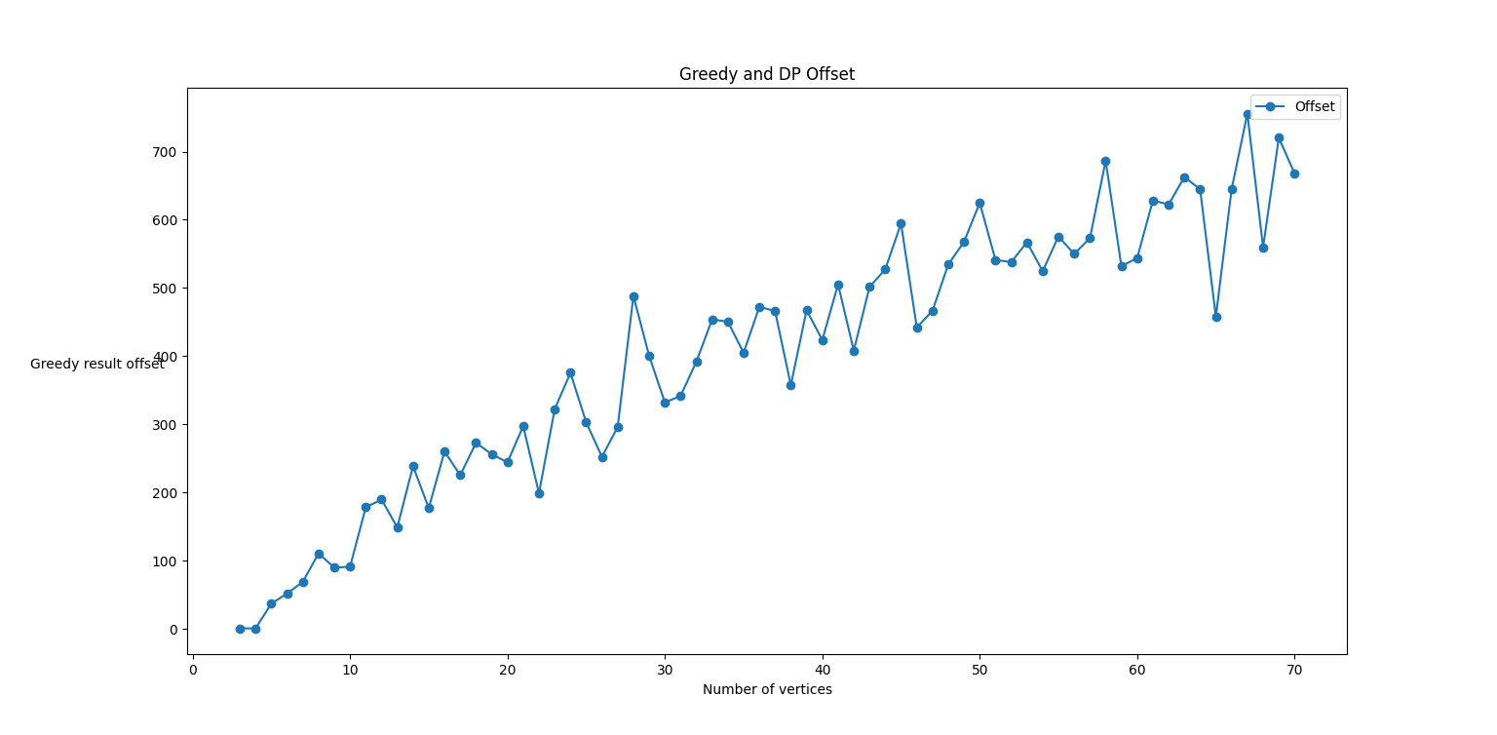
Observation
Greedy vs DP (Time Taken)
Offset of how much Greedy result is more than that of the optimal DP result.
We can clearly see that the DP and the Greedy results show mismatch which becomes significant when the number of vertices in the polygon is significantly high.

Slide 13
2. Data Compression Strategies:
Shannon Fano and Huffman
Data compression is a technique used to reduce the size of data by encoding it in a more efficient manner. Two very popular algorithms for data compression are Shannon-Fano and Huffman coding.
Shannon-Fano coding is a prefix code where each symbol is assigned a binary code based on its probability of occurrence in the data.
Huffman coding is also a prefix code where each symbol is assigned a variable length binary code based on its frequency of occurrence in the data.
Both are lossless data compression techniques, meaning that there is no loss of data in data compression and decompression.

Slide 14
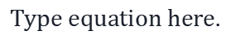
Background…
The problem of finding the prefix code with the minimum expected length is equivalent to finding the set of lengths l1,l2 , . . . , lm satisfying the Kraft inequality and whose expected length is L=Σlipi less than the expected length of any other prefix code.
The mathematics yields us the following result: H(X) ≤ L < H(X) + 1 where H(X) here is the file entropy that gives a quantitative measure of the degree of randomness in the file.
( H(X) is calculated as Σ pi log(1/pi) )
The above inequality shows that the average codeword length L for the prefix code must be greater than or equal to the entropy H of the source.
This relationship between entropy and codeword length is a fundamental result in information theory, and it shows that the optimal average codeword length for a prefix code is equal to the entropy of the source.

Slide 15
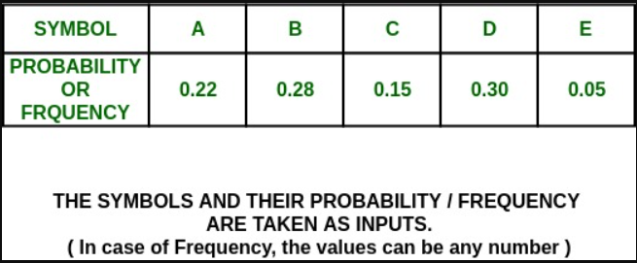
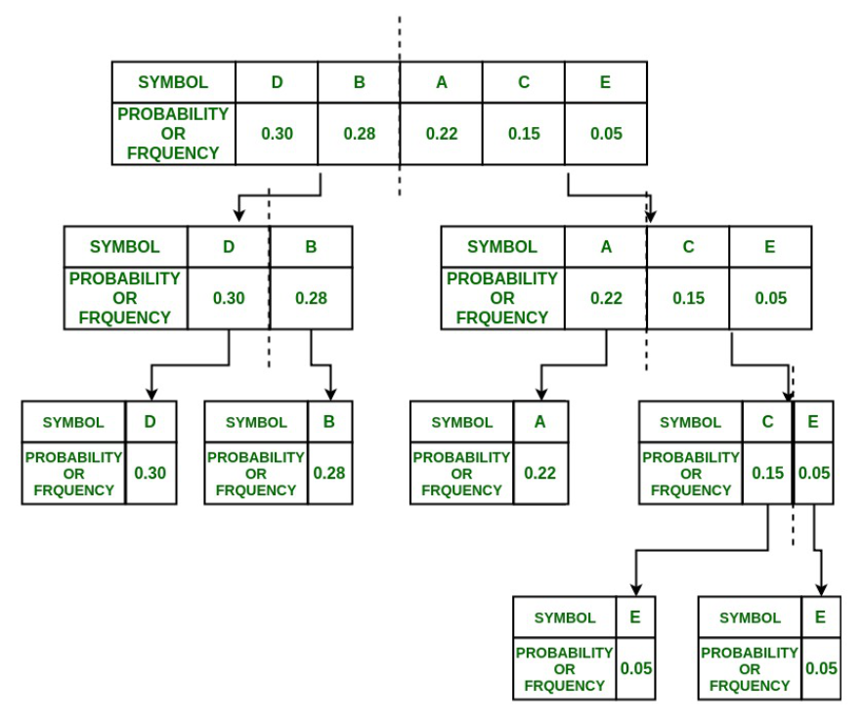


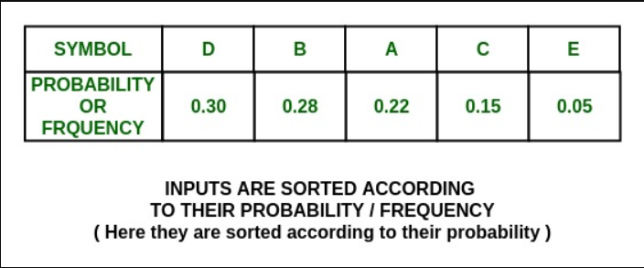
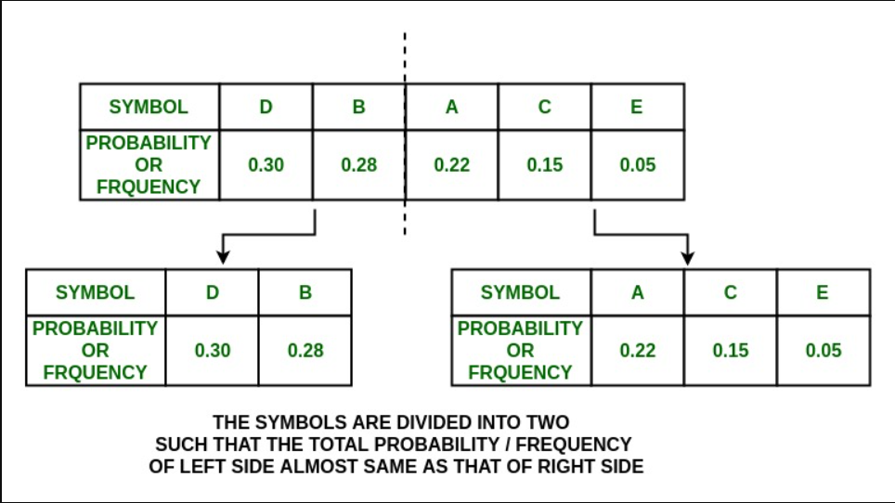
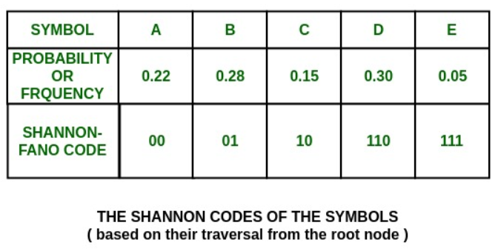
2(a) Encoding algorithm for Shannon-Fano
How it works:
Step 1:
Step 4:
Step 2:
Step 3:
Step 5:

Slide 16
Code for assigning Shannon Codes:
typedef struct{
char symbol;
int freq;
double prob;
char code[40];
int top;
} char_data;
void shannon_fano(char_data* char_freq, int start, int end)
{
if (start >= end) return;
double total_prob = 0;
for (int i = start; i <= end; i++)
total_prob += char_freq[i].prob;
double half_prob = total_prob / 2.0;
double current_prob = 0;
int split_index = -1
if(end - start >= 2)
for (int i = start; i <= end; i++)
current_prob += char_freq[i].prob;
if (current_prob >= half_prob){
split_index = i-1;
if(split_index < start)
split_index++;
break;
}
else
split_index = start;
for (int i = start; i <= end; i++){
int index_offset =
(i <= split_index) ? 0 : split_index+1;
char bit = (i <= split_index) ? '0' : '1';
char_freq[i].code[++char_freq[i].top] = bit;
char_freq[i].code[char_freq[i].top+1] = '\0';
}
shannon_fano(char_freq, start, split_index);
shannon_fano(char_freq, split_index+1, end);
}

Slide 17
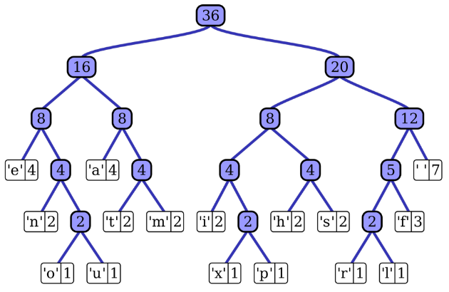
Procedure for Compression:
Procedure for Decompression:
Assumption: A maximum of 256 ASCII characters can be present in the text file. So, we create an array of 256 elements to store the Shannon Fano codes. Index of each element corresponds to its ASCII value. This is our codebook for the file.
We open the document to be compressed, read character by character and corresponding to each character we visit the relevant array position in the codebook to get the Shannon Fano code.
Then we write the codeword for the character in a separate new file to store the encoded form of the text file.
The codebook is used to create a Shannon Fano tree. This is basically a binary tree such that the higher probability characters reside at the upper portion of the tree.
During traversal of the encoded text file, we start from the root of the Shannon Fano tree and move left or right based on whether the current bit is 0 or 1. We continue this process until we reach a leaf node, at which point we output the corresponding character to the decoded text file and start again from the root of the tree.

Slide 18
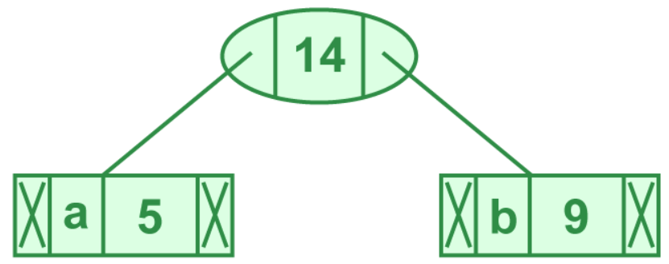
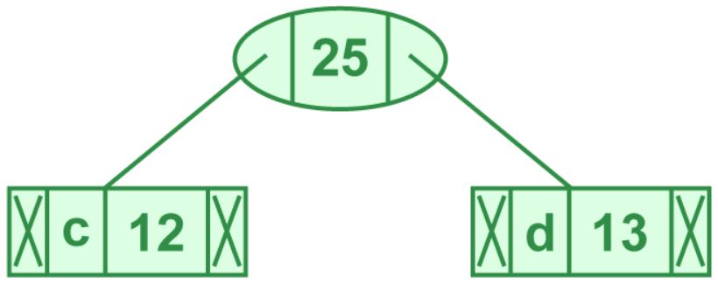
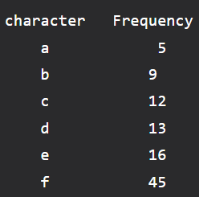
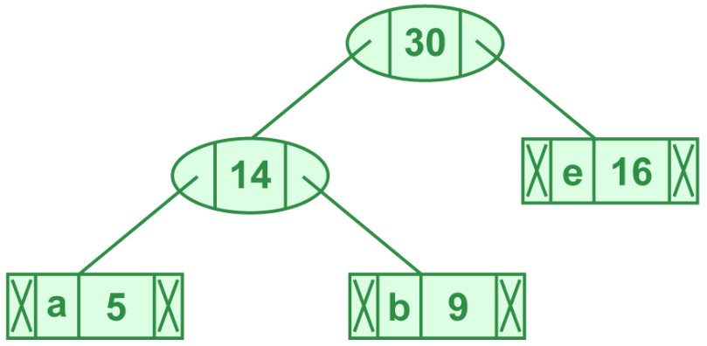
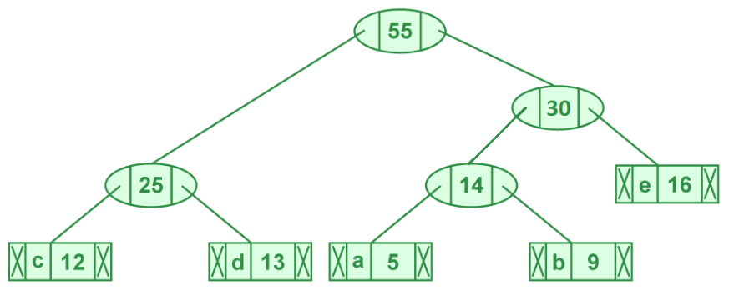
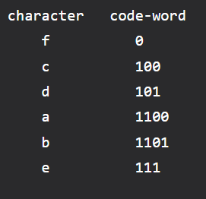
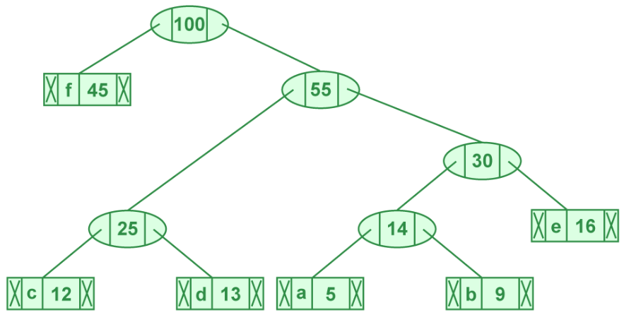
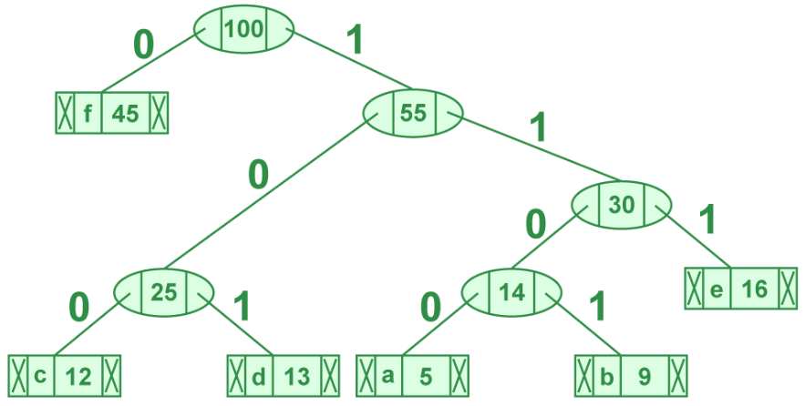
2(b) Huffman encoding using heap
How it works:
Step 1:
Step 2:
Step 3:
Step 4:

Slide 19
Code for assigning Huffman codes:
Node* buildHuffmanTree(unordered_map<char, int>& freq_map){
Node* nodes[freq_map.size()]; // to store the nodes of the Huffman Tree
int i = 0;
for (auto& pair : freq_map)
nodes[i++] = new Node(pair.first, pair.second);
// Build the Huffman Tree using a heap
while (i > 1){
int min1 = 0, min2 = 1; //min1 for smallest frequency and min2 for second smallest
if (nodes[min1]->freq > nodes[min2]->freq)
swap(min1, min2);
for (int j = 2; j < i; j++)
if (nodes[j]->freq < nodes[min1]->freq){
min2 = min1; min1 = j;
}
else if (nodes[j]->freq < nodes[min2]->freq)
min2 = j;
// Create a new node with the sum of the frequencies of the two smallest nodes
Node* parent = new Node('\0', nodes[min1]->freq + nodes[min2]->freq);
parent->left = nodes[min1];
parent->right = nodes[min2];
// Remove the two smallest nodes from the array and add the new node
nodes[min1] = parent;
nodes[min2] = nodes[i - 1];
i--;
}
return nodes[0]; // Return the root of the Huffman Tree
}
struct Node{
char ch;
int freq;
string code;
Node* left, * right;
Node(char ch, int freq);
};

Slide 20
Compressing a File using Huffman Codes:
void encodeFile(string original_file, string encoded_file)
{
unordered_map<char, int> freq_map;
char ch;
ifstream infile(original_file);
while (infile >> noskipws >> ch)
freq_map[ch]++;
infile.close();
Count the frequency of each character in the input file and store it in a frequency map
Node* root = buildHuffmanTree(freq_map);
Build the Huffman Tree using the frequency map
unordered_map<char, string> Codemap;
traverse(root, "", Codemap);
Traverse the Huffman Tree and store the Huffman codes in a map
ofstream outfile(encoded_file);
infile.open(original_file);
while (infile >> noskipws >> ch)
outfile << Codemap[ch];
infile.close();
outfile.close();
}
Encode the input file using the Huffman codes and write the encoded data to output file

Slide 21
Decompressing the File:
// Traverse the Huffman tree to decode the input string
void decodeFile(Node* root, const string encoded_file, const string decoded_file)
{
// Open the input and output files
ifstream inFile(encoded_file, ios::binary);
ofstream outFile(decoded_file, ios::binary);
// Traverse the Huffman tree for each character in the input file
Node* current = root;
char c;
while (inFile.get(c))
{
if (c == '0')
current = current->left;
else
current = current->right;
if (current->left == nullptr && current->right == nullptr)
{
outFile.put(current->ch);
current = root;
}
}
// Close the input and output files
inFile.close();
outFile.close();
}
Encode the input file using the Huffman codes and write the encoded data to output file

Slide 22
Experimental Procedure :
A sample of 54 large text documents were taken up for data compression/ decompression experiment
Shannon Fano Experiment:
Each of the files were individually compressed and compression ratios were plotted
To get a better understanding of the degree of compression, the average codeword length was plotted along with the theoretical entropy values of each of the files.
Huffman Experiment:
Experiment I:
A cumulative frequency-distribution of all the characters in all the text files was taken and based on that, Huffman codes were assigned. This was then used to compress the file
Once again, the relevant plots were recorded
Experiment II
This time, instantaneous encoding-decoding were done using Huffman
Experiment I vs II were plotted to get an understanding of how Experiment I result deviates from the practical optimum Huffman compression
Huffman vs Shannon Fano plots were done to observe which of them on an average gave better results for compression

Slide 23
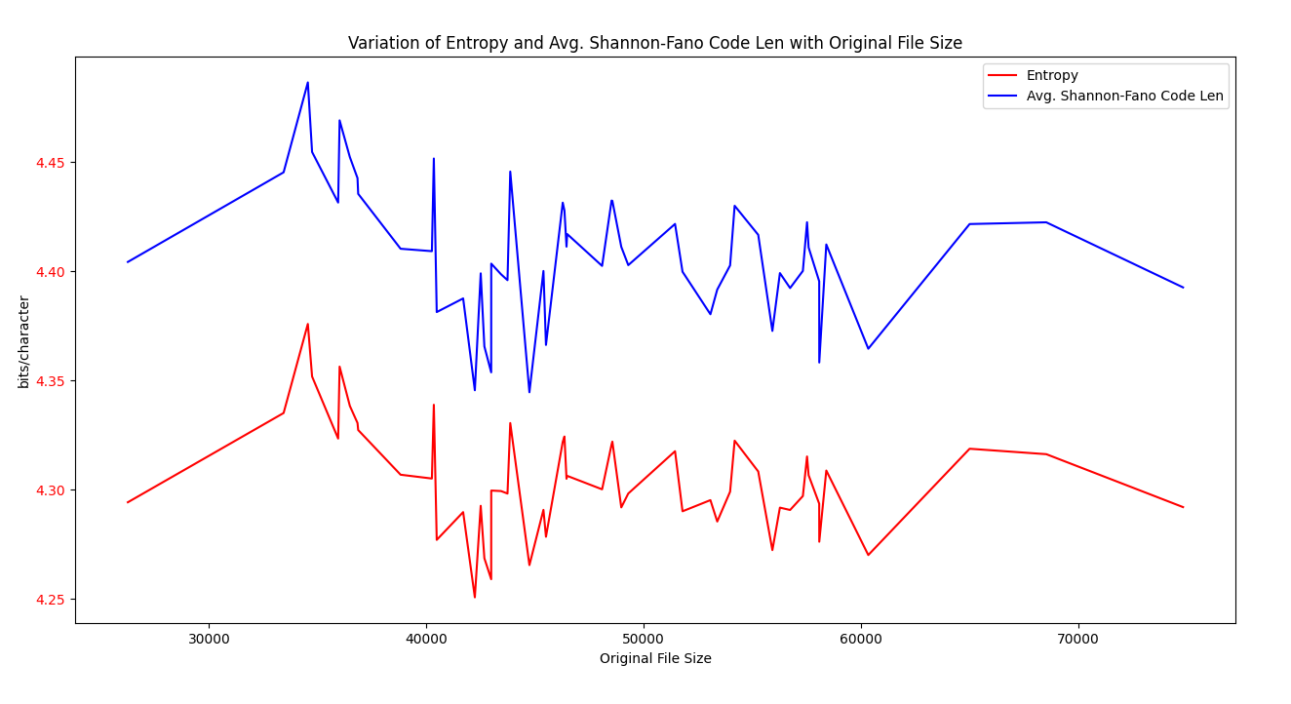
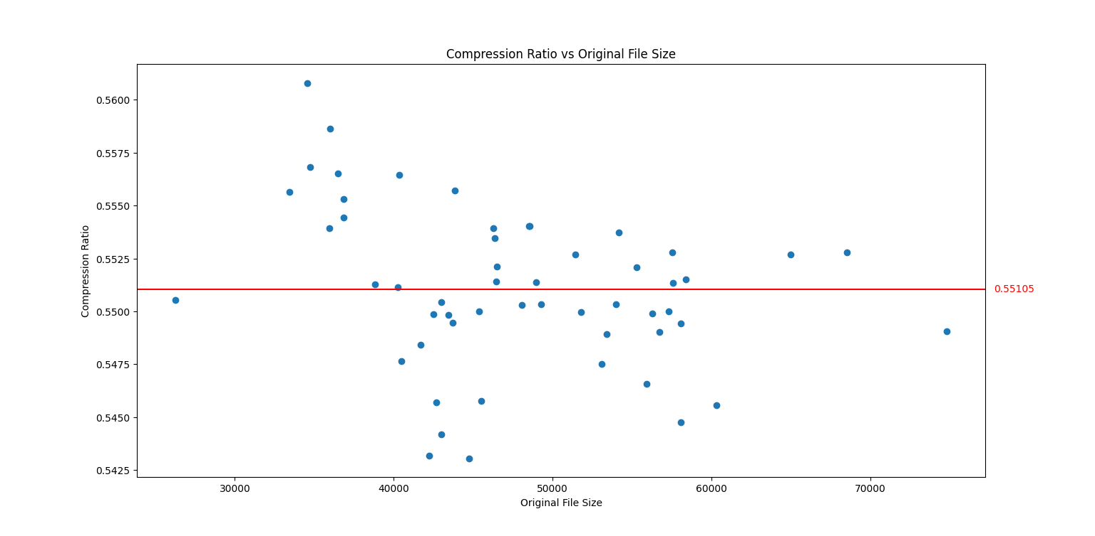
Shannon Fano Experiment Result:

Slide 24
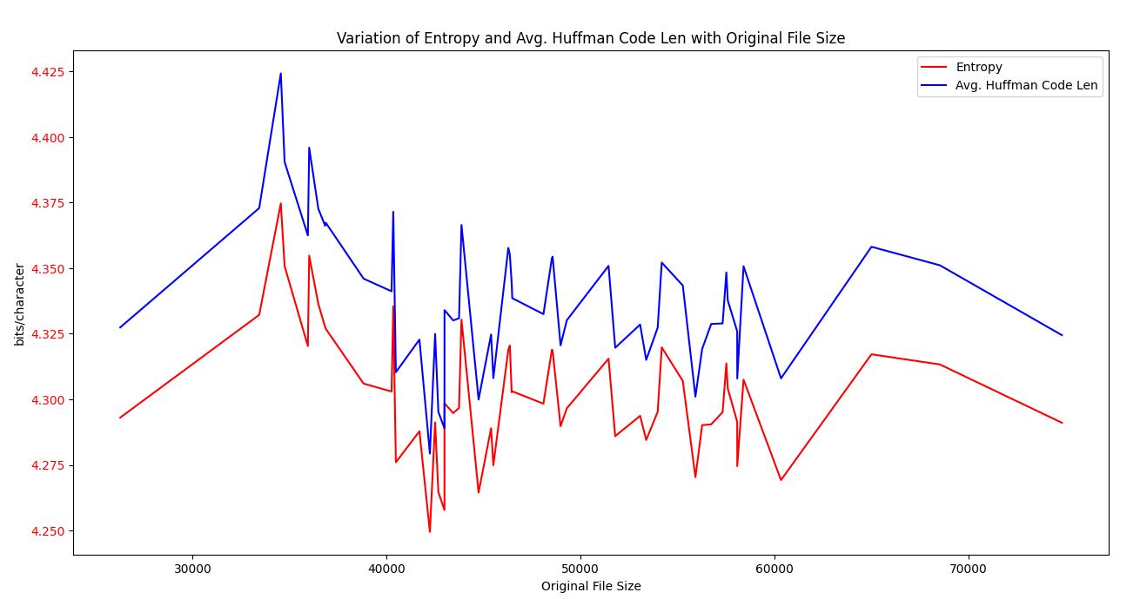
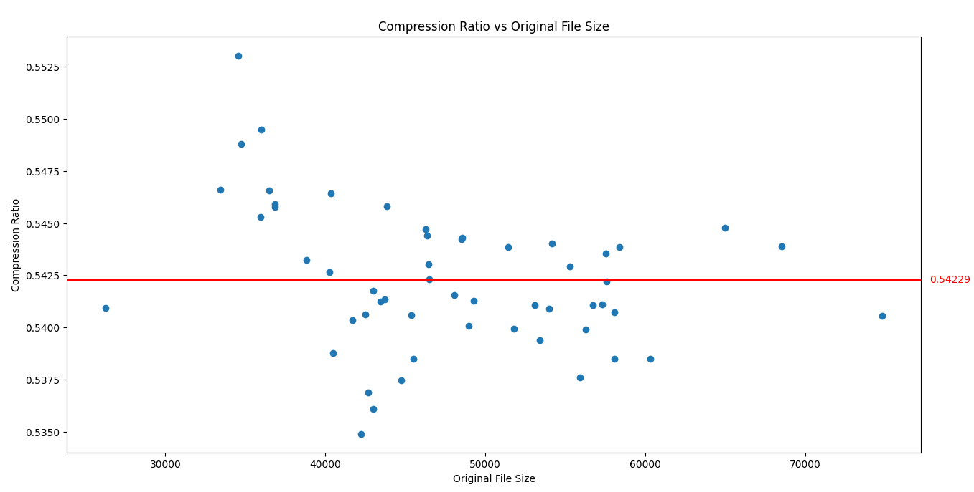
Huffman Experiment I (Cumulative Frequency):

Slide 25
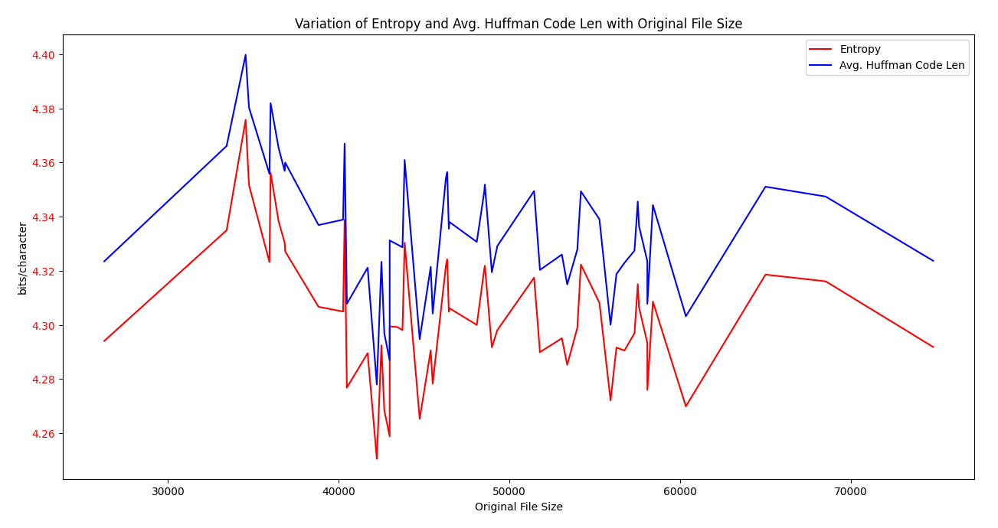
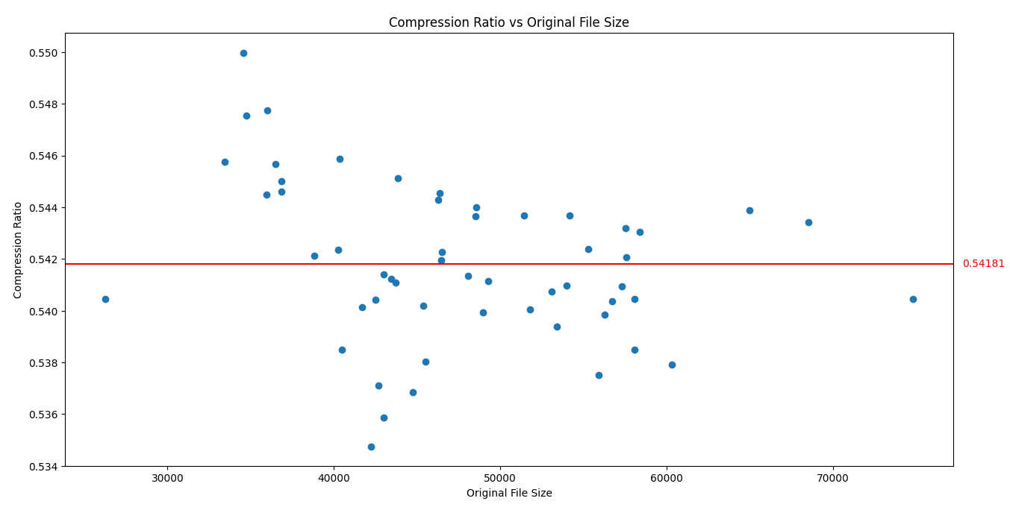
Huffman Experiment II (Instantaneous):

Slide 26
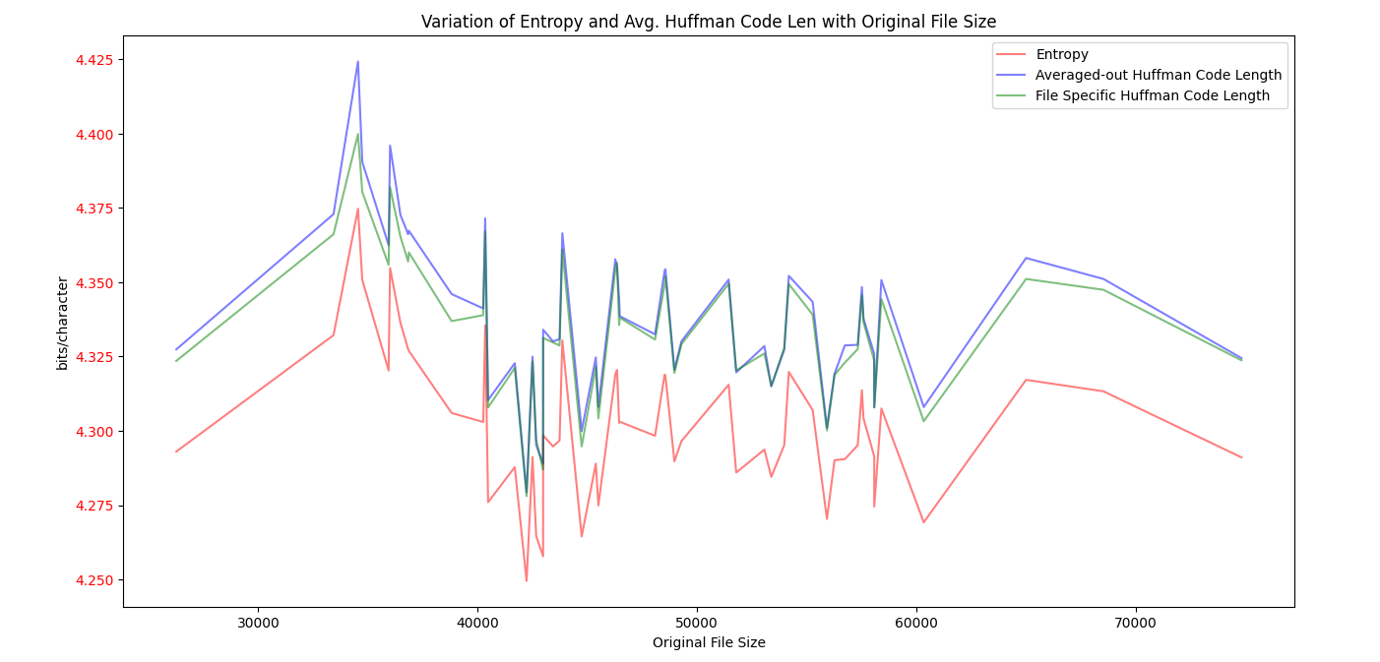
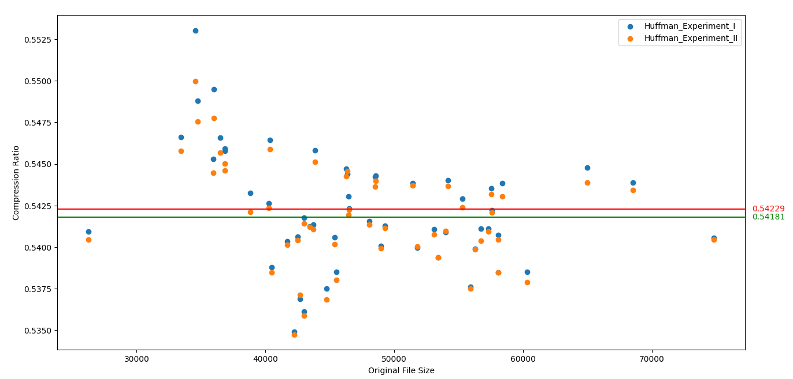
Huffman Experiment I vs II:

Slide 27
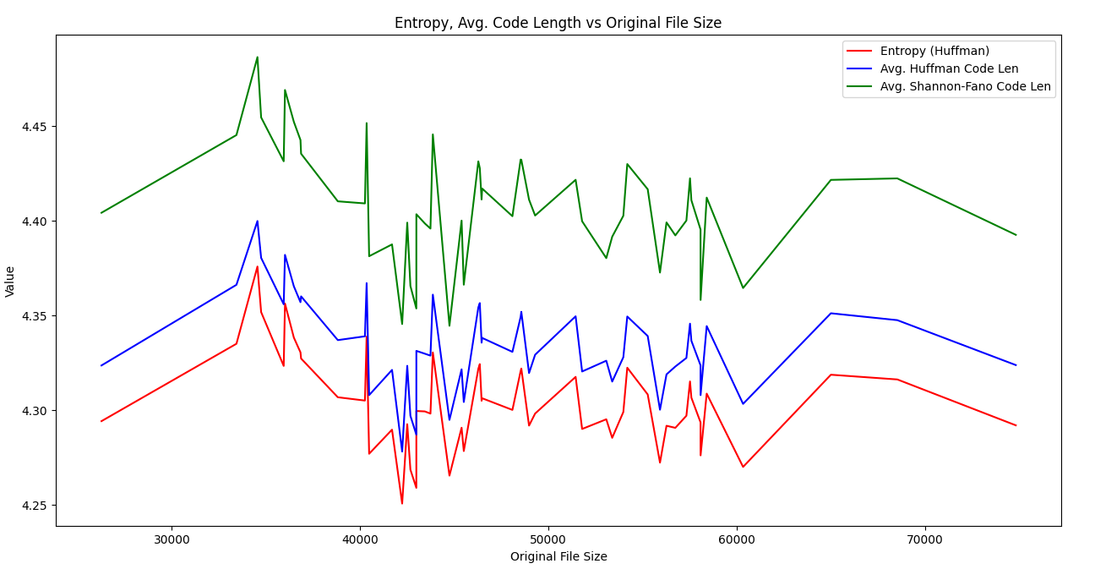
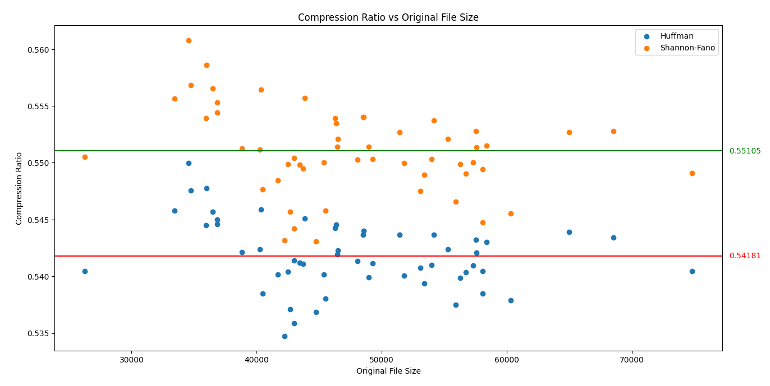
Shannon Fano vs Huffman (Instantaneous)

Slide 28
Observations :
Compression Ratio: Huffman coding generally achieves better compression ratios compared to Shannon-Fano. This is because Huffman coding generates the most efficient code words for each symbol based on their frequency of occurrence using optimal merge pattern, whereas Shannon-Fano uses a divide-and-conquer approach that may not always result in the optimal code words.
Optimal substructure:
In Huffman coding, the optimal prefix codes for a given set of symbols can be obtained by combining the optimal prefix codes of its subsets of symbols. So Huffman algorithm is able to find the optimal prefix code for a set of symbols by solving smaller subproblems.
Shannon-Fano coding does not exhibit optimal substructure because it uses a divide-and-conquer approach that may not result in the optimal code words for each symbol.
Greedy Choice Property:
At each step, Huffman coding selects the two symbols with the lowest probabilities and merges them into a single node. This greedy choice ensures that the optimal prefix codes are obtained for the entire set of symbols.
At each step, Shannon-Fano coding splits the remaining symbols into two groups based on their probabilities, and assigns a 0 or 1 bit to each group. This greedy choice may not always result in the optimal prefix codes for the entire set of symbols.

Slide 29
PART - III
3. We need to scale up the things - from toy problems to real life problems. For this, you need to study some large datasets provided by reputed Universities, like
(a) SNAP - Stanford Network Analysis Project - datasets collected by Stanford University.
(b) KONECT - Koblenz Network Collection - datasets compiled by Koblenz University, Deutschland (Germany).
First study and feel the vastness of these networks from the dynamic and disjoint set operations point of view. Then try to implement graph algorithms like Connected Components and Minimum Spanning Tree using appropriate data structure for these datasets.

Slide 30
The concepts
Minimum Spanning Tree (MST) is a concept in graph theory that refers to a subset of edges of a connected, weighted graph that connects all the vertices together without any cycles and with the minimum possible total edge weight. In other words, an MST is a tree (i.e., a connected graph without cycles) that spans (i.e., covers) all the vertices of a graph with the minimum possible total weight.
Connected components refer to the subgraphs of a graph that are connected (i.e., there is a path between any two vertices) and cannot be further divided into smaller connected subgraphs. In other words, a connected component is a maximal subgraph in which every vertex is reachable from any other vertex.

Slide 31
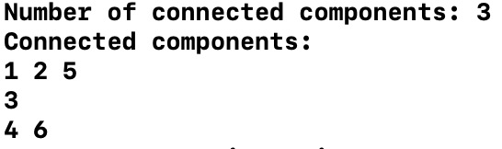
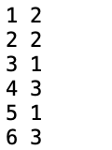
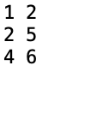
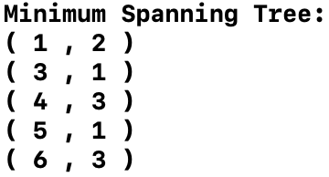

SAMPLE DATA
OUTPUTS
MEMBERSHIP FILE
CONNECTIVITY FILE
CONNECTED COMPONENTS O/P
MINIMUM SPANNING TREE (MST) O/P
^ TESTING THE ALGORITHMS ON A SAMPLE TOY DATASET ^

Slide 32
Implementation Details
We have implemented the disjoint set union data-structure using linked-list and tree-based approaches.
We have tested the algorithm on:-
SNAP (Email-EU-Core-Network)
SNAP (COM-YouTube)
SNAP (EGO-Facebook)
KONECT (Full USA Road-Map)

Slide 33
Dataset Generic Details
All the datasets used have a similar format (all .txt)
Dataset had commented lines in the start which had number of vertices and edges of the dataset
After that every line was a set of two numbers, which defined an edge. Using these two properties it was easy to derive a way to extract data from the dataset.

Slide 34
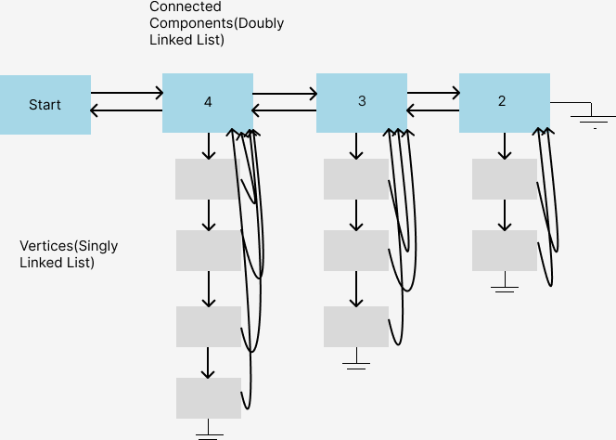
Linked List Based Implementation
Here we used Two Linked Lists, One for dynamically managing number of Connected Components of the graph (also called Representative(Set) Element), and other to maintain the list of vertices inside that connected component.
The Connected Component list is doubly linked while the vertices list in singly linked.
Every Representative Node also has a length parameter(for union operations), which stores the length of vertex linked list inside it.
Every vertex also has a representative pointer which points to its Connected Component Node
The amortized time complexity in this implementation is O(log N), N being the number of edges in the dataset.

Slide 35
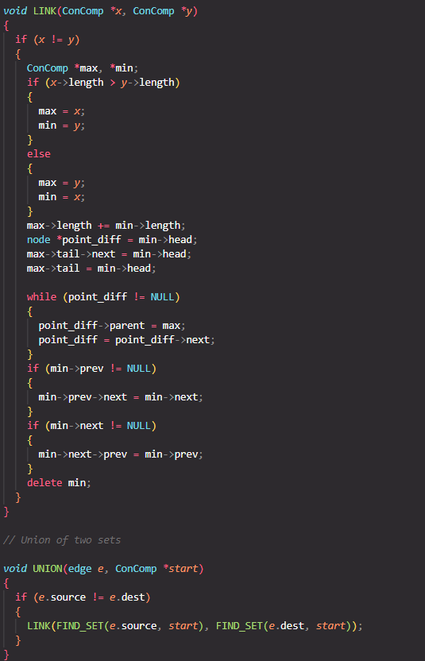
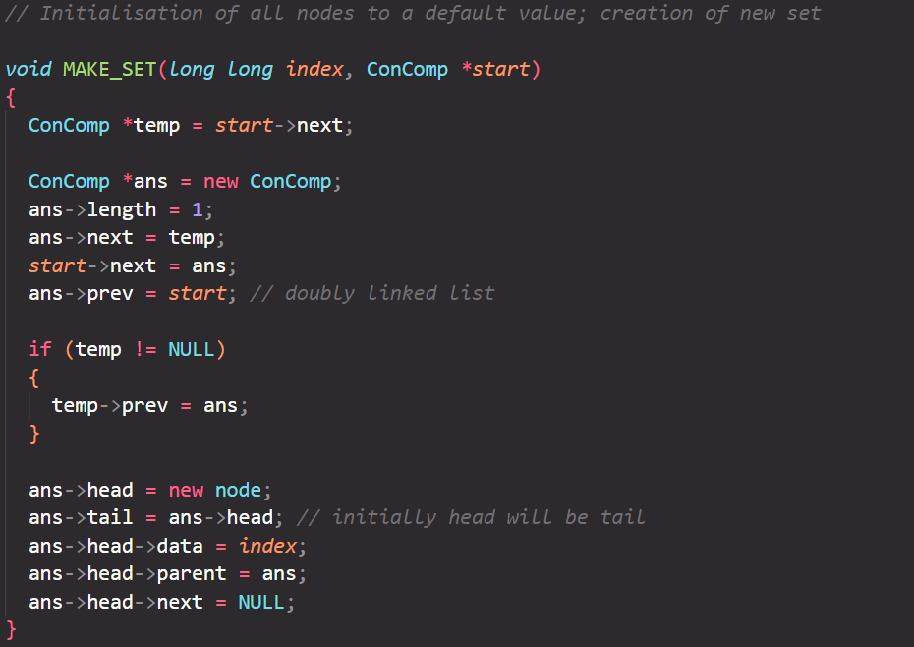
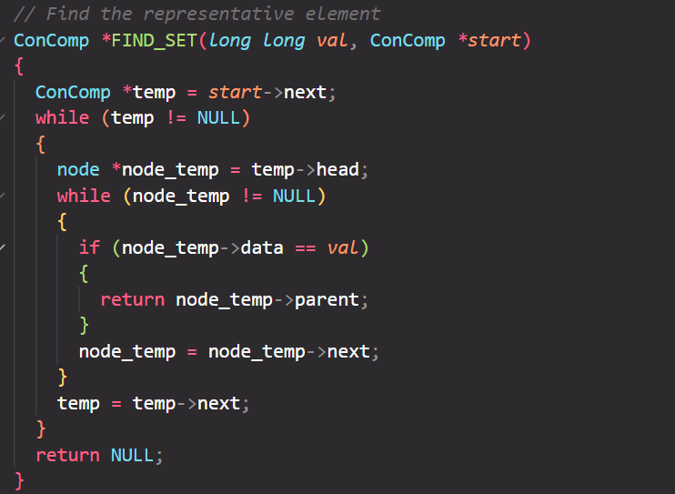
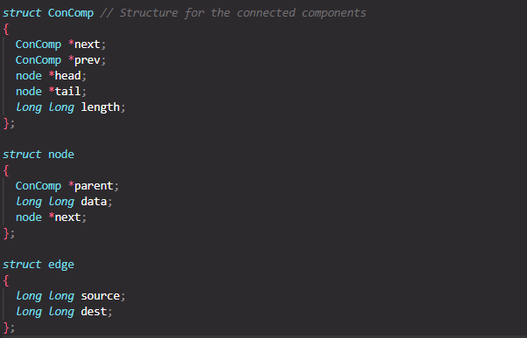
Code Snippet

Slide 36
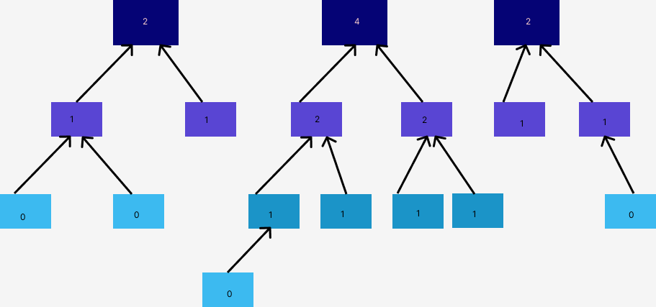
Tree Based Implementation
Here we have only vertex as nodes, which have two extra data other than its value :-
1. Rank
2. Parent Pointer
Rank of a node signifies how big the subtree with the node as root is. Parent pointer of a node points to one of the nodes which are the parents of the node. Preferable to the node with highest node in the tree (the main root)
Expected Amortized Time Complexity in this Implementation is:- O(log*N); N being the number of edges
The above implementation can also be realized using vectors(CPP)

Slide 37
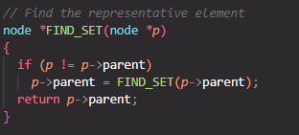
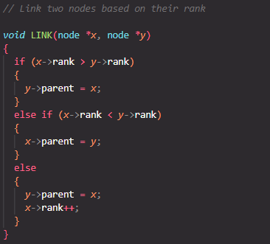
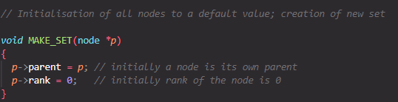
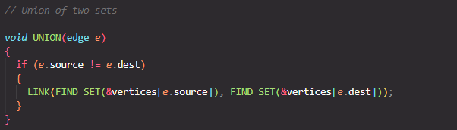
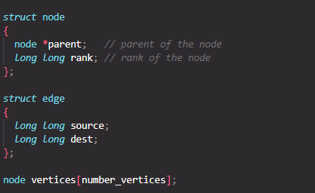
Code Snippet

Slide 38

Class Based Implementation in C++

Slide 39
Observation of Union-Find Operations on the dataset
SNAP Facebook (vertices: 4039, edges: 88234)
a. Tree Based: 252.87 ms
b. Linked List Based: 321.124 ms
SNAP Youtube (vertices: 1134890, edges: 2987624)
a. Tree Based: 3249.98 ms (3.3 sec)
b. Linked List Based: 1202489 ms (20.04 min)
SNAP EU-Core Email (vertices:1005 , edges: 25571)
a. Tree Based: 50.86 ms
b. Linked List Based: 198.61ms
KONECT Full-USA (vertices: 23947347, edges: 57708624)
a. Tree Based: 81014 ms (1.35 min)
b. Linked List Based: Ran for approx. 1.5 hours, to reach 0.3% completion

Slide 40


Implementation of Kruskal MST

Slide 41
Observations
The previous implementation of connected components and Kruskal MST was performed on the EU-Email dataset.
The observations for connected components can be found here and for MST can be found here
From the above implementations we can see that the array based implementation of Disjoint Set Data-Structure provides faster results compared to the linked-list based.

